Slide 1
Protein binding sites of other let7 miRNA gene families
서창완
1. Are there other let7 miRNA gene family in human genome?
1. Grep "mirlet" from annotation.gtf
2. Read as pandas dataframe
3. Filter feature "transcript"
chr | start | end | strand | attribute
chr9 | 41448012 | 41448107 | + | Mirlet7a-2
chr9 | 1.06E+08 | 1.06E+08 | + | Mirlet7g
chr10 | 1.23E+08 | 1.23E+08 | - | Mirlet7i
chr13 | 48689488 | 48689590 | - | Mirlet7d
chr13 | 48691305 | 48691393 | - | Mirlet7f-1
chr13 | 48691655 | 48691748 | - | Mirlet7a-1
chr15 | 85590804 | 85590898 | + | Mirlet7c-2
chr15 | 85591520 | 85591604 | + | Mirlet7b
chr16 | 77396545 | 77396638 | + | Mirlet7c-1
chr17 | 18050614 | 18050706 | + | Mirlet7e
chrX | 150695342 | 150695424 | + | Mirlet7f-2
Yes. 8 other let7 miRNA exists

Slide 2
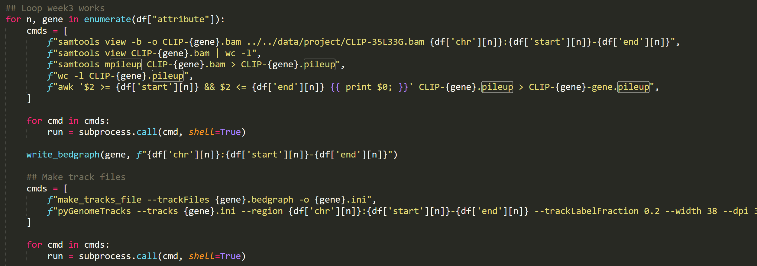
Protein binding sites of other let7 miRNA gene families
서창완
2. Are there protein binding sites for other let7 miRNAs?
Total 11 genes -> Automation!
Automate week3 works
subprocess.call -> integrate shell script to python
f-strings for good command representation
Automate visualization?

Slide 3
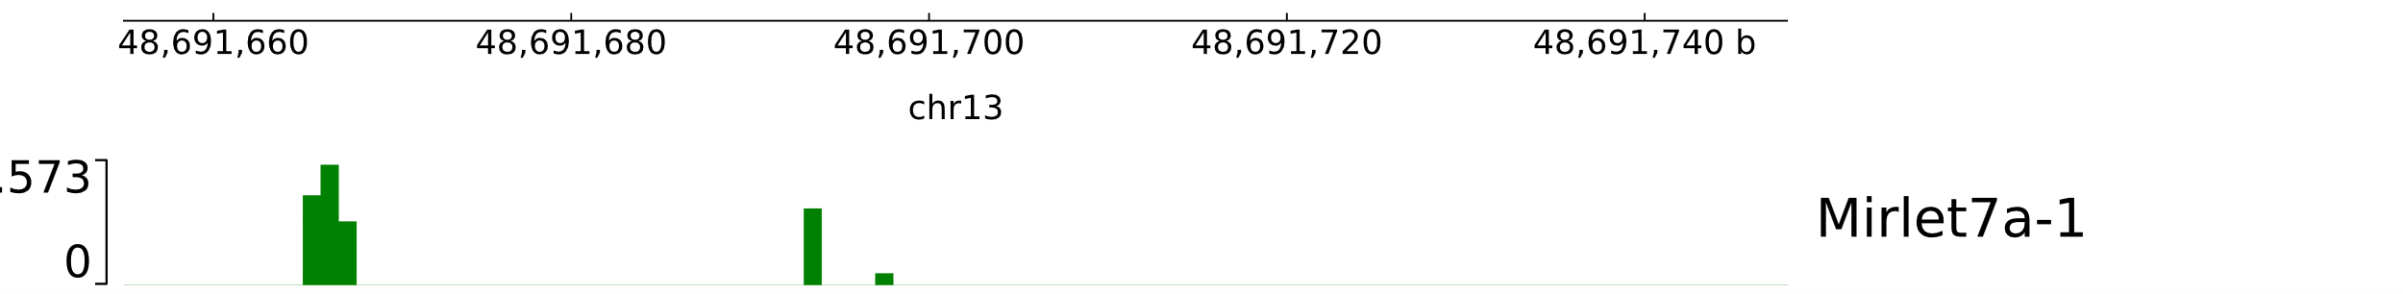
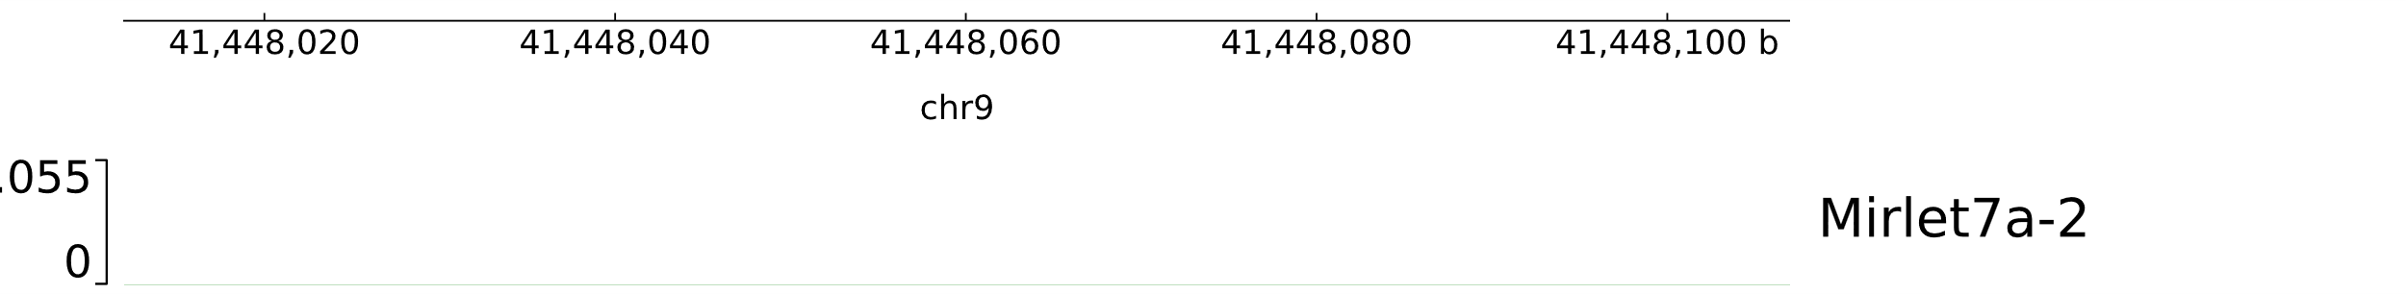
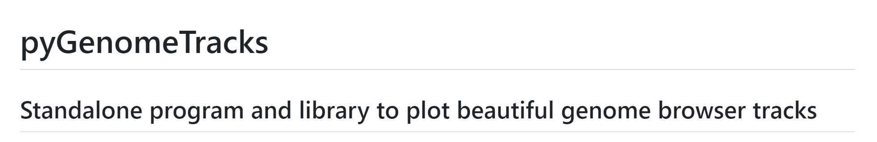
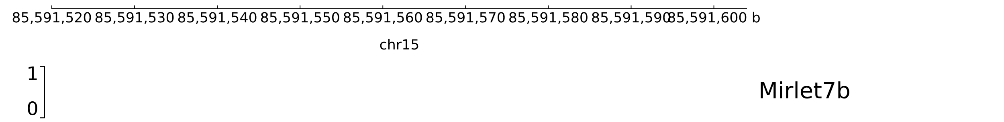
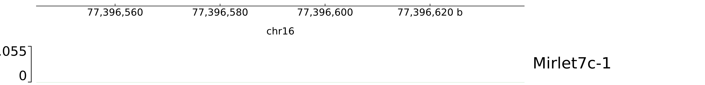
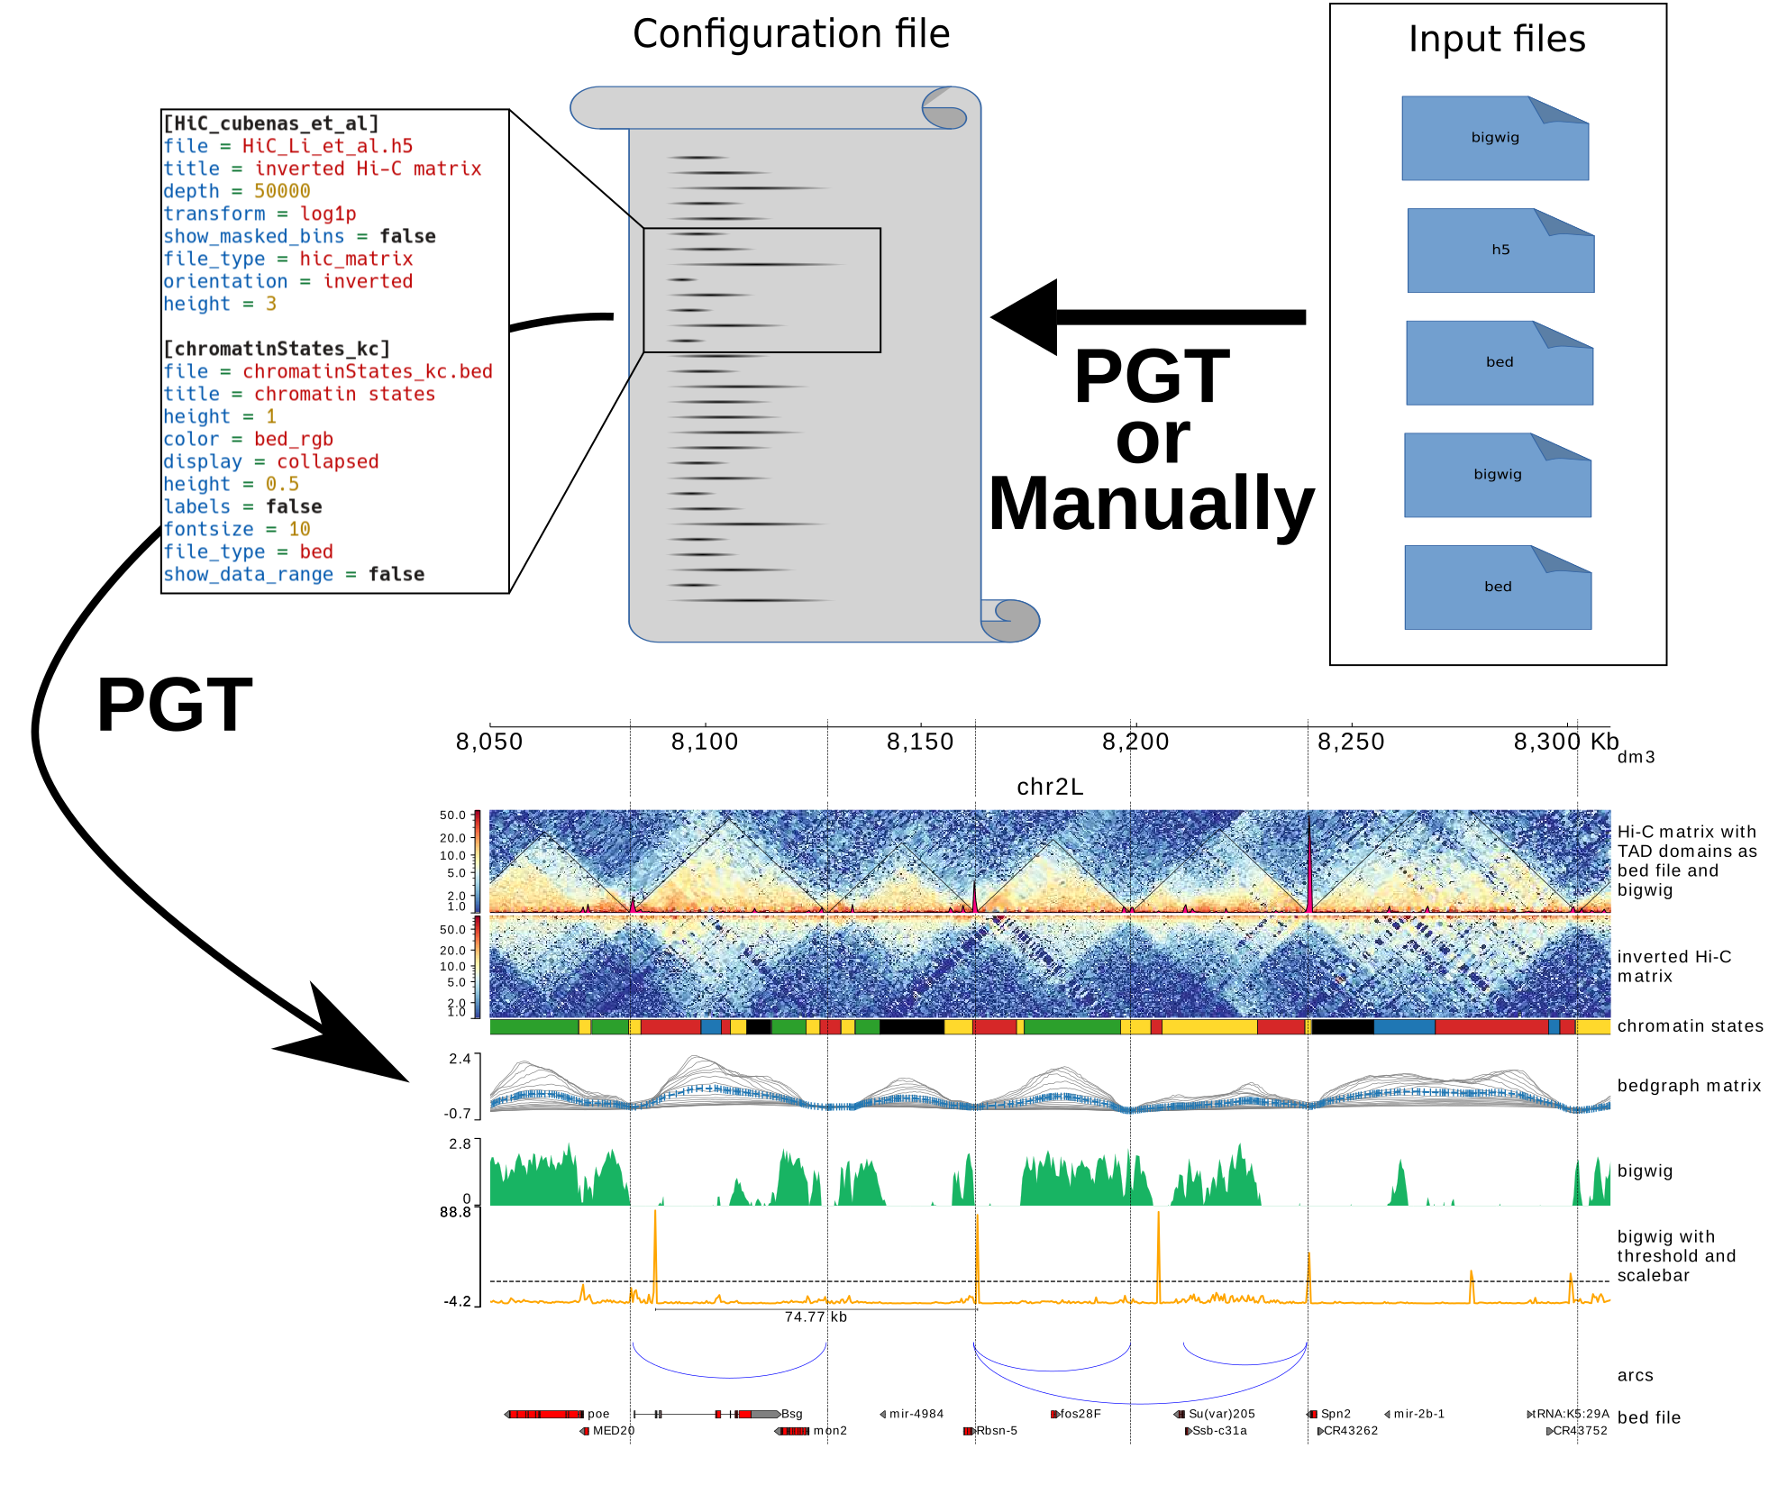

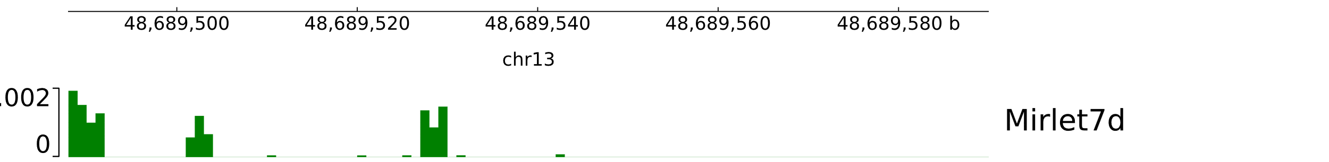
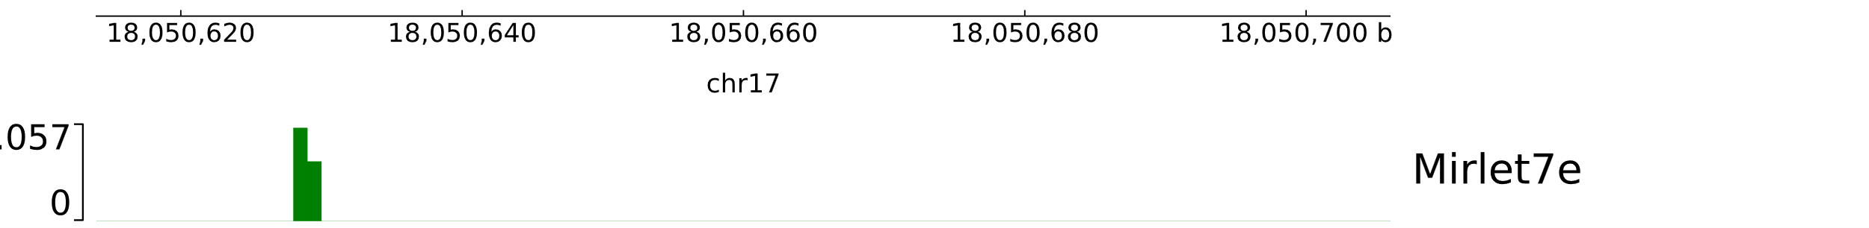
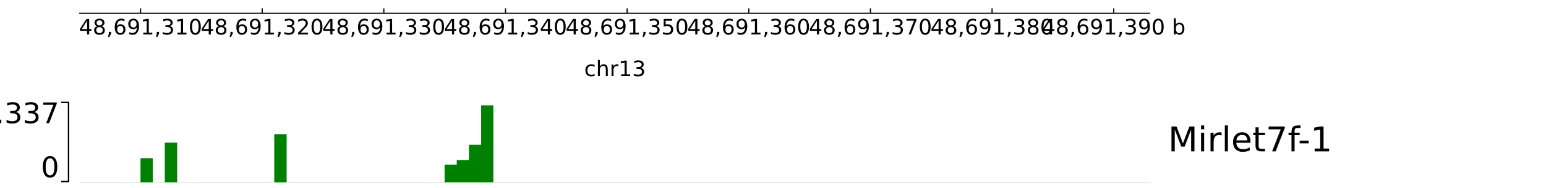
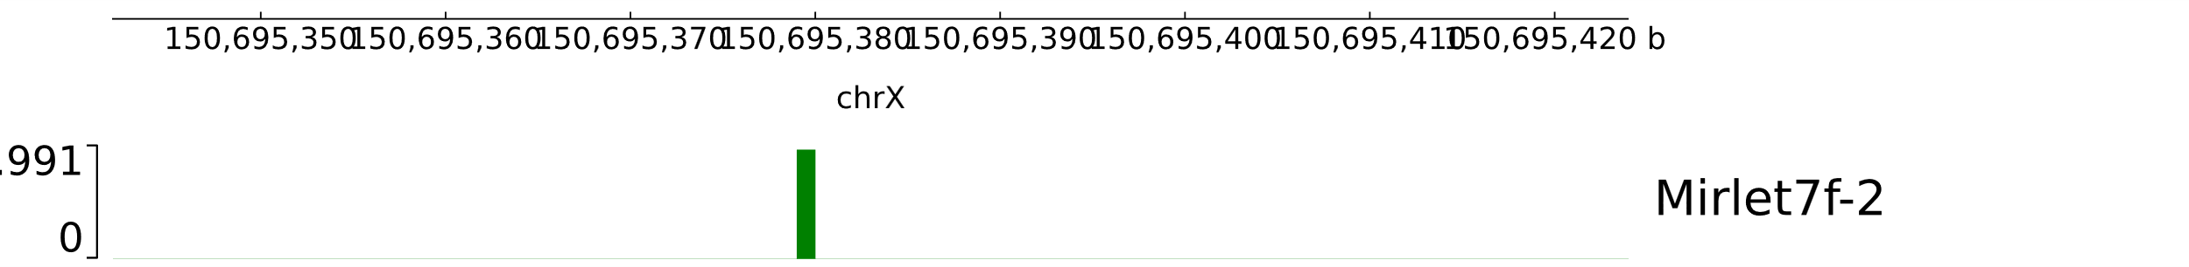
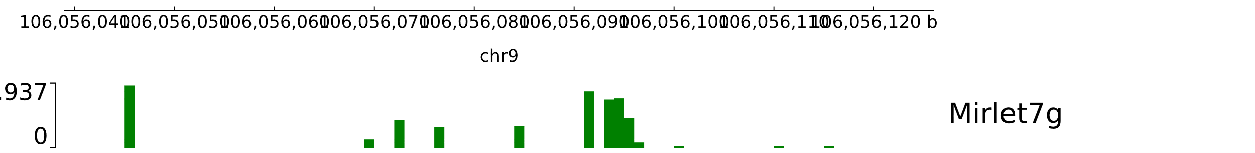
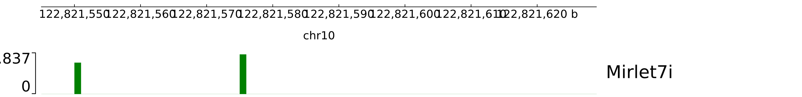
Protein binding sites of other let7 miRNA gene families
서창완
2. Are there protein binding sites for other let7 miRNAs?
서창완
Visualization with pyGenomeTracks
https://github.com/deeptools/pyGenomeTracks
Yes. Mirlet7a-1, Mirlet7e, Mirlet7f-2, Mirlet7i had binding sites

Slide 4
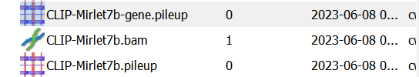
Protein binding sites of other let7 miRNA gene families
서창완
3. How about other 4 let7 miRNAs with no binding sites?
서창완
1. Mirlet7b did not had any corresponding RNA reads
2. Others did not had binding site from the experiment

Slide 5
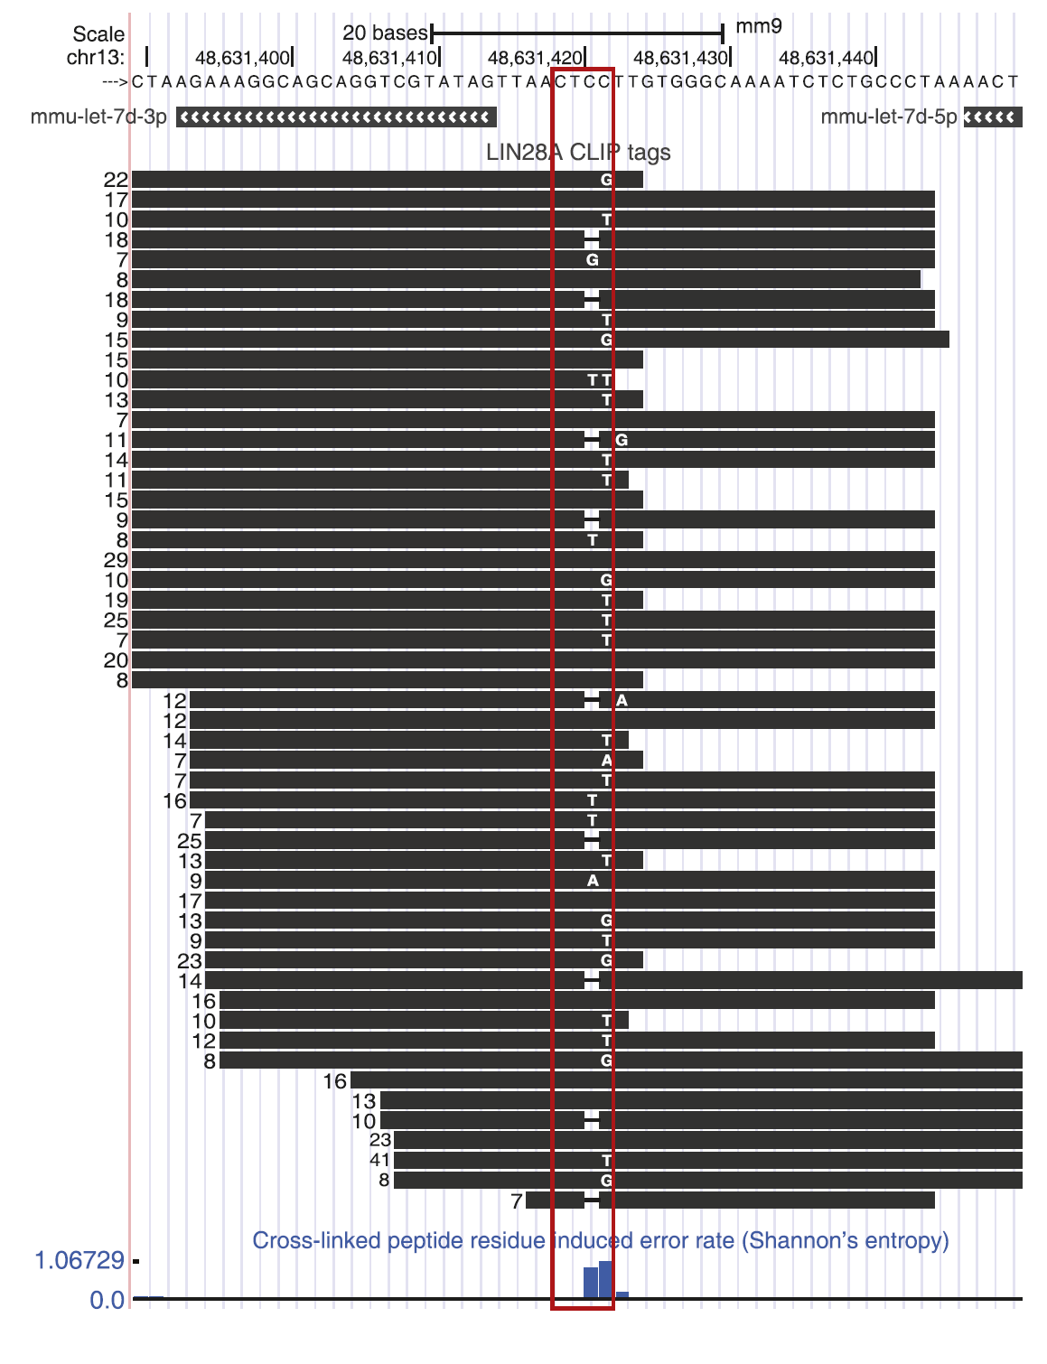
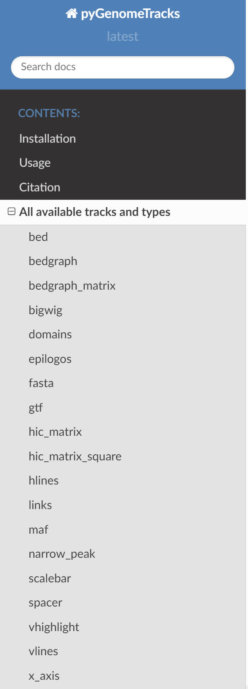
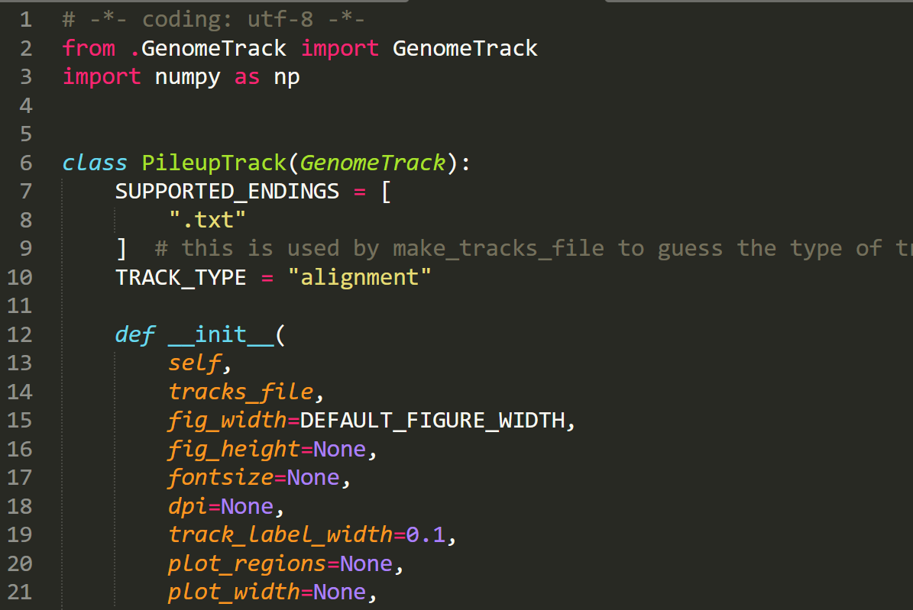
Protein binding sites of other let7 miRNA gene families
서창완
Extra. 삽질들
서창완
윗부분도 자동화해보고 싶었음!
그러나 PygenomeTracks는 mpileup format을 지원하지 않음
PileupTrack.py
직접 pileup format 추가에 도전
Failed

Slide 6
Protein binding sites of other let7 miRNA gene families
서창완
1. Are there other let7 miRNA gene family in human genome?
Yes. 8 other "mirlet7" genes found by pandas filtering
2. Are there protein binding sites for other let7 miRNAs?
Yes. Binding sites are found from 4 other "mirlet7" genes by automaing week3 works and visualization
3. How about other 4 let7 miRNAs with no binding sites?
Mirlet7b did not had any corresponding RNA reads, while others did not had binding site from the experiment found by inspecting raw data
서창완

